Slide 1
Introduction to Artificial Intelligence [AICS223] Assignment [1]
Student Number/Name

Slide 2
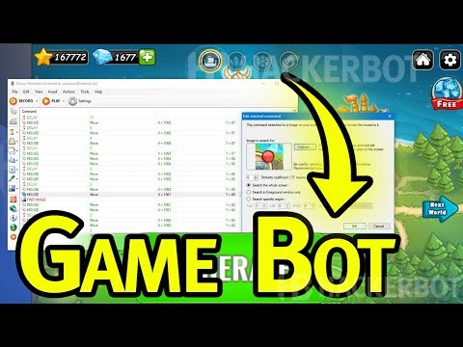
Assignment [1]
Topic 예시)
Online game security -> Game Bots

Slide 3
Assignment [1]
Topic 예시)
Online game security -> Game Bots

Slide 4
Thank you

